Slide 1


SOFTWARE ENGINEERING (Week-4)
Usama Musharaf
Lecturer (Department of Computer Science)
FAST-NUCES Peshawar

Slide 2
Contents of week # 4
Architectural Styles
Categories of Architectural Style
Hierarchical Software Architecture
Layered
Data Flow Software Architecture
Pipe and Filter
Batch Sequential
Data Centered Software Architecture
Black board
Shared Repository
Component-Based Software Architecture

Slide 3
Architectural Styles
“A set of design rules that identify the kinds of components and connectors that may be used to compose a system.
The architectural style is a very specific solution to a particular software system, which typically focuses on how to organize the components created for the software.

Slide 4
Components of a style
The key components of an architecture style are:
Elements/components
that perform functions required by a system
connectors
that enable communication, coordination, and cooperation among elements
constraints
that define how elements can be integrated to form the system
attributes
that describe the advantages and disadvantages of the chosen structure

Slide 5
Categories of Architectural Styles
Hierarchical Software Architecture
Layered
Data Flow Software Architecture
Pipe and Filter
Batch Sequential
Data Centered Software Architecture
Black board
Shared Repository
Component-Based Software Architecture
Distributed Software Architecture
Client Server
Peer to Peer
REST
SOA
Microservices
Cloud Architecture
Event Based Software Architecture

Slide 6
Hierarchical Software Architecture

Slide 7
Hierarchical Style
The hierarchical software architecture is characterized by viewing the entire system as a hierarchy structure.
The software system is decomposed into logical modules (subsystems) at different levels in the hierarchy.

Slide 8
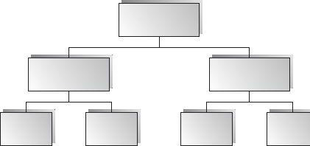
Hierarchical Style
Modules at different levels are connected by method invocations.
a lower-level module provides services to its adjacent upper-level modules, which invokes the methods or procedures in the lower level.

Slide 9
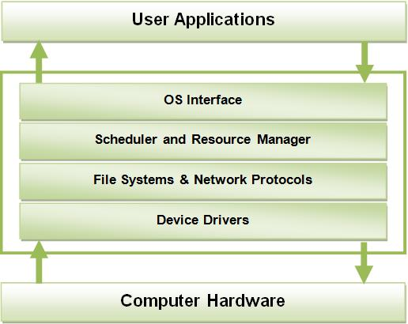
Hierarchical Style
System software is typically designed using the hierarchical architecture style.

Slide 10
Layered Architecture

Slide 11
Layered Style
Organized hierarchically into layers.
Each layer provides service to the layer above it and serves as a client to the layer below.
The connectors are defined by the protocols that determine how the layers will interact.

Slide 12
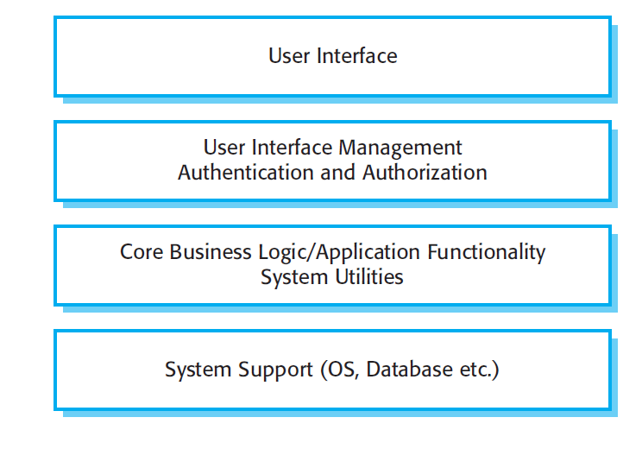
A generic Layered Architecture

Slide 13
Layered Virtual Machine Example: Java
Java
Java
Operating
Java Virtual Machine
Processor
(Virtual Machine Style)
System
Virtual Machine
Application

Slide 14
Layered System Example: OSI Protocol Stack
Application
Application
Presentation
Presentation
Session
Session
Transport
Transport
Network
Network
Network
Network
Data Link
Data Link
Data Link
Data Link
Physical
Physical
Physical
Physical

Slide 15
Applicable domains of layered architecture:
Any system that can be divided between the application-specific portions and platform-specific portions which provide generic services to the application of the system.
Applications that have clean divisions between core services, critical services, user interface services, etc.
Applications that have a number of classes that are closely related to each other so that they can be grouped together into a package to provide the services to others.

Slide 16
Benefits:
Incremental software development based on increasing levels of abstraction.
Enhanced independence of upper layer to lower layer since there is no impact from the changes of lower layer services as long as their interfaces remain unchanged.

Slide 17
Benefits (Cont..)
Enhanced flexibility: interchangeability and reusability are enhanced due to the separation of the standard interface and its implementation.
Promotion of portability: each layer can be an abstract machine deployed independently.

Slide 18
Limitations:
Lower runtime performance since a client's request or a response to a client must go through potentially several layers.
There are also performance concerns of overhead on the data processing and buffering by each layer.

Slide 19
Limitations (Cont..)
Breach of interlayer communication may cause deadlocks, and “bridging” may cause tight coupling.
Exceptions and error handling are issues in the layered architecture, since faults in one layer must propagate upward to all calling layers.

Slide 20
Data flow Software Architecture

Slide 21
Data Flow Architectures
The data flow software architecture style views the entire software system as a series of transformations on successive sets of data.
The software system is decomposed into data processing elements where data directs and controls the order of data computation processing.

Slide 22
Data Flow Architectures
Each component in this architecture transforms its input data into corresponding output data.
In general, there is no interaction between the modules except for the output and the input data connections between subsystems.

Slide 23
Data Flow Architectures
One subsystem can be substituted by another without affecting the rest of the system
Since each subsystem does not need to know the identity of any other subsystem, modifiability and reusability are important property attributes of the data flow architecture.
Example: Image Processing

Slide 24
Batch Sequential

Slide 25
Batch – Sequential
In batch sequential architecture, each data transformation subsystem or module cannot start its process until its previous subsystem completes its computation.
Data flow carries a batch of data as a whole from one subsystem to another.

Slide 26
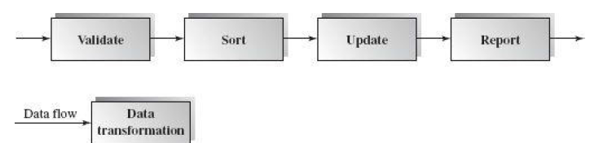
First subsystem validates the transaction requests (insert, delete, and update) in their totality.
Next, the second subsystem sorts all transaction records in an ascending order on the primary key of data records
The transaction update module updates the master file with the sorted transaction requests, and then
the report module generates a new list.
The architecture is in a linear data flow order.

Slide 27
Benefits:
• Simple divisions on subsystems.
• Each subsystem can be a stand-alone program working on input data and producing output data.

Slide 28
Limitations:
• It does not provide interactive interface.
• Concurrency is not supported and hence throughput remains low.
• High latency.

Slide 29
Pipes-and-Filters Style

Slide 30
Pipe and Filter
This architecture decomposes the whole system into components of data source, filters, pipes, and data sinks.
The connections between components are data streams.
The particular property attribute of the pipe and filter architecture is its concurrent and incremented execution.

Slide 31
Filter
Each filter is an independent data stream transformer;
it reads data from its input data stream, transforms and processes it, and then
writes the transformed data stream over a pipe for the next filter to process.

Slide 32
Filter
A filter does not need to wait for batched data as a whole.
As soon as the data arrives through the connected pipe, the filter can start working right away.

Slide 33
Pipes
The connectors serve as channels for the streams, transmitting outputs of one filter to inputs of the other.
This makes connectors act as Pipes.

Slide 34
Pipes
A pipe moves a data stream from one filter to another.
A pipe is placed between two filters; these filters can run in separate threads of the same process.

Slide 35

Structure

Slide 36
Examples
Traditional Compilers:
Compilation phases are pipelined, though the phases are not always incremental. The phases in the pipeline include:
lexical analysis + syntax analysis (parsing) + semantic analysis + code optimization + code generation

Slide 37
Example: Architecture of a Compiler
Compilation is regarded as a sequential (pipeline) process.
Every phase is dependent on some data on the preceding phase.
text
Lex
Syn
Sem
Opt
CGen
code

Slide 38
Benefits:
Concurrency: It provides high overall throughput for excessive data processing.
Reusability: Encapsulation of filters makes it easy to plug and play, and to substitute.
Flexibility: It supports both sequential and parallel execution.

Slide 39
Benefits:
Modifiability: It features low coupling between filters, less impact from adding new filters, and modifying the implementation of any existing filters as long as the I/O interfaces are unchanged.
Simplicity: It offers clear division between any two filters connected by a pipe.

Slide 40
Disadvantages
Not good choice for interactive systems, because of their transformational characteristic.

Slide 41
Data centered / shared data software architecture

Slide 42
Shared Data Software Architecture
Data-centered software architecture is characterized by a centralized data store that is shared by all surrounding software components.
The software system is decomposed into two major partitions: data store and independent software component or agents.

Slide 43
Shared Data Software Architecture
In pure data-centered software architecture, the software components don't communicate with each other directly; instead, all the communication is conducted via the data store.
The shared data module provides all mechanisms for software components to access it, such as insertion, deletion, update, and retrieval.

Slide 44
Shared Data:
Blackboard style
Repository style

Slide 45
Repository architecture

Slide 46
Repository Architecture
The repository architecture style is a data-centered architecture that supports user interaction for data processing.
The software component agents of the data store control the computation and flow of logic of the system.

Slide 47
Repository architecture
All data in a system is managed in a central repository that is accessible to all system components.
Components do not interact directly, only through the repository.
physician
diagnosis
Lab testing
Patient
database
pharmacy &
drug processing
accounting
& administration

Slide 48
Repository architecture
Organizing tools around a repository is an efficient way to share large amounts of data.
There is no need to transmit data explicitly from one component to another.
Although it is possible to distribute a logically centralized repository, there may be problems with data redundancy and inconsistency.
In practice, it may be difficult to distribute the repository over a number of machines.

Slide 49
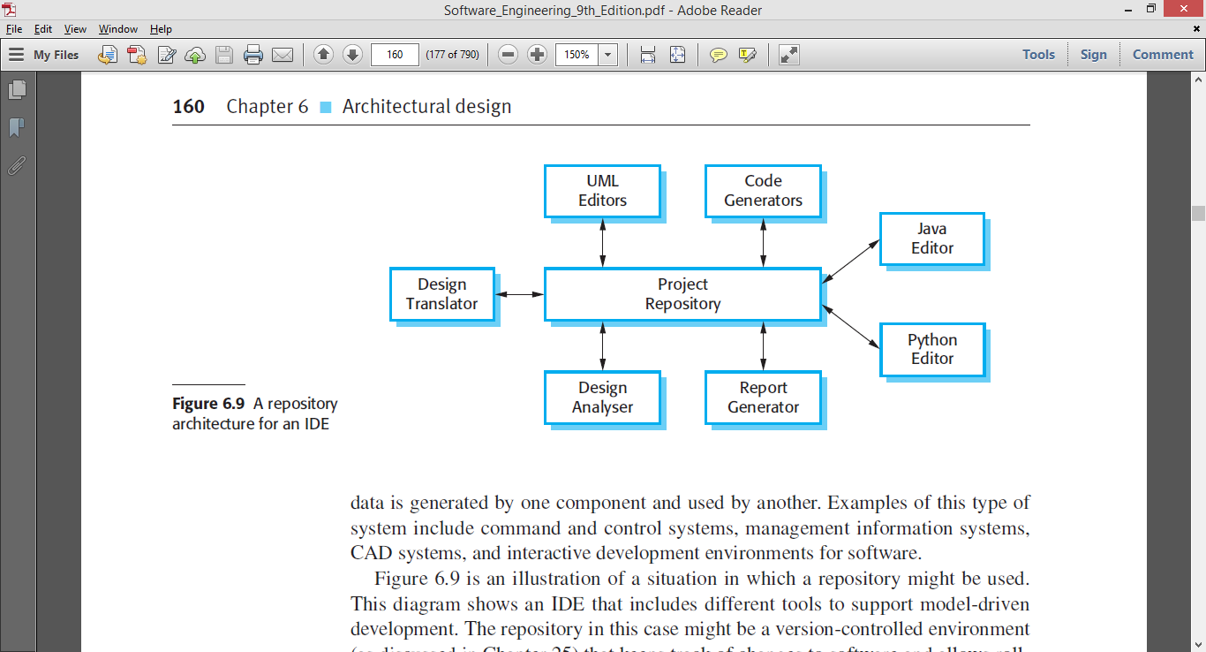
Example: Integrated Development Environment

Slide 50
Applicable domains of repository architecture:
Suitable for large, complex information systems where many software component clients need to access them in different ways
Requires data transactions to drive the control flow of computation

Slide 51
Advantages
Components can be independent—they do not need to know of the existence of other components.
Changes made by one component can be propagated to all components.
All data can be managed consistently (e.g., backups done at the same time) as it is all in one place.

Slide 52
Disadvantages
The repository is a single point of failure so problems in the repository affect the whole system.
May be inefficiencies in organizing all communication through the repository.
Distributing the repository across several computers may be difficult.

Slide 53
Blackboard architecture

Slide 54
Blackboard architecture
The blackboard architecture was developed for speech recognition applications in the 1970s.
Other applications for this architecture are image pattern recognition and weather broadcast systems.

Slide 55
Blackboard architecture
The word blackboard comes from classroom teaching and learning.
Teachers and students can share data in solving classroom problems via a blackboard.
Students and teachers play the role of agents to contribute to the problem solving.
They can all work in parallel, and independently, trying to find the best solution.

Slide 56
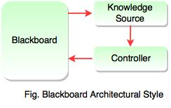
Blackboard architecture
The entire system is decomposed into two major partitions.
One partition, called the blackboard, is used to store data.
while the other partition, called knowledge sources, stores domain specific knowledge.
There also may be a third partition, called the controller, that is used to initiate the blackboard and knowledge sources and that takes a main role and overall supervision control.

Slide 57
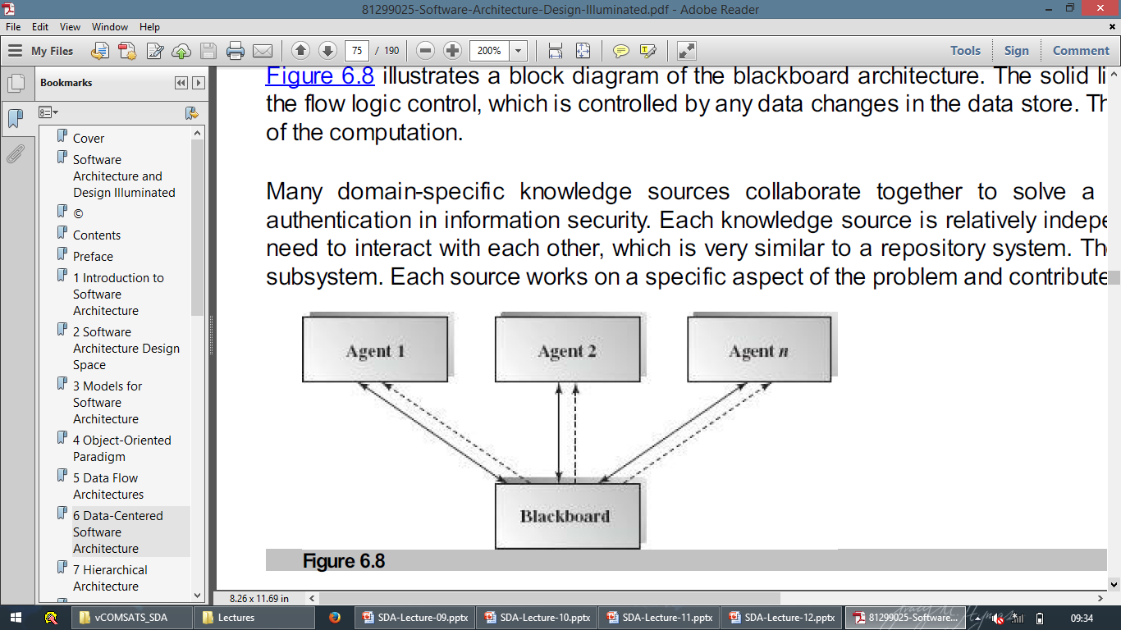
Blackboard architecture - Connections
Data changes in the blackboard trigger one or more matched knowledge source to continue processing.
This connection can be implemented in publish/subscribe mode.

Slide 58
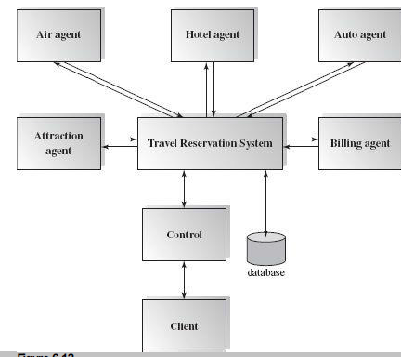
Example - Travel Consulting System
There may be many air travel agencies, hotel reservation systems, car rental companies, or attraction reservation systems to subscribe to or register with through this travel planning system.

Slide 59
Example - Travel Consulting System
Once the system receives a client request, it publishes the request to all related agents and composes plan options for clients to choose from.

Slide 60
Example - Travel Consulting System
The system also stores all necessary data in the database.
After the system receives a confirmation from the client, it invokes the financial billing system to verify credit background and to issue invoices.

Slide 61
Example - Travel Consulting System
The data in the data store plays an active role in this system.
It does not require much user interaction after the system receives client requests since the request data will direct the computation and activate all related knowledge sources to solve the problem.

Slide 62
Applicable domain:
Suitable for solving complex problems such as artificial intelligence (AI) problems where no preset solutions exist.

Slide 63
Benefits:
Scalability: easy to add or update knowledge source.
Concurrency: all knowledge sources can work in parallel since they are independent of each other.
Reusability of knowledge source agents.

Slide 64
Component based software architecture

Slide 65
Component-Based Software Engineering
CBSE is an approach to software development that relies on reuse
CBSE emerged from the failure of object-oriented development to support reuse effectively
Objects (classes) are too specific and too detailed to support design for reuse work

Slide 66
Component
A software component is an independently deployable implementation of some functionality, to be reused as it is in a broad spectrum of applications.
For a software component what it provides and requires should be clearly stated so that it can be used without any ambiguity.

Slide 67
Component Based Software Architecture
The main motivation behind component-based design is component reusability.
Designs can make use of existing reusable commercial off-the-shelf (COTS) components or ones developed in-house, and they may produce reusable components for future reuse.

Slide 68
Categories Of Components
Commercial of-the-shelf components- complete application libraries readily available in the market.
Qualified components—assessed by software engineers to ensure that not only functionality, but also performance, reliability, usability, and other quality factors conform to the requirements of the system/product to be built.
Adapted components—adapted to modify (wrapping) unwanted or undesired characteristics.

Slide 69
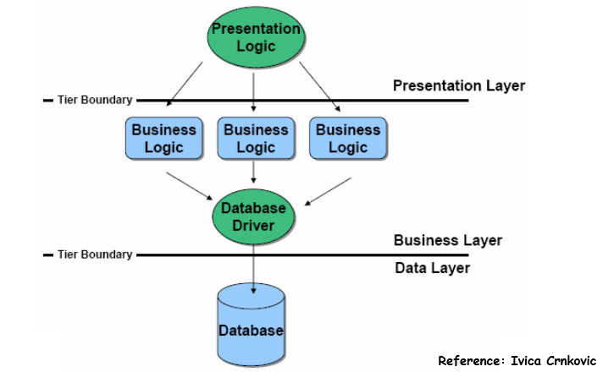
N tier Architecture

Slide 70
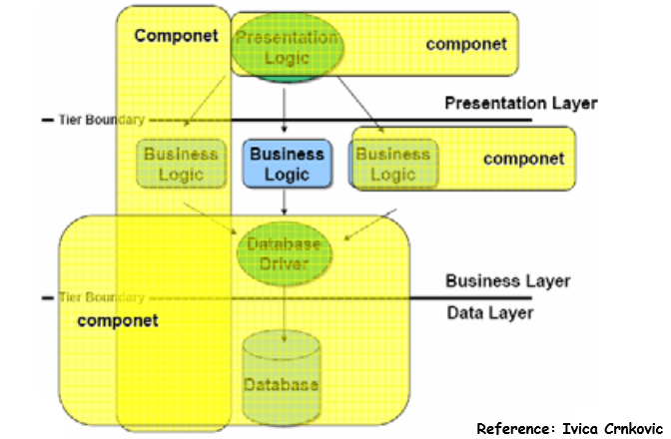

Slide 71
Connectors
Connectors connect components, specifying and ruling their interaction.
Component interaction can take the form of
method invocations,
asynchronous invocations such as
event listener and registrations,
broadcasting,

Slide 72
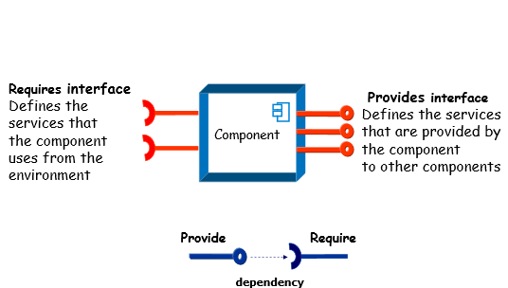

Slide 73
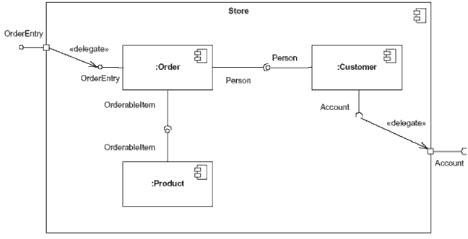
Component Diagram
Figure: This component's inner structure is composed of other components

Slide 74
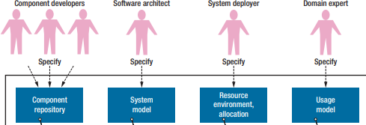
Elements of a Component Model

Slide 75
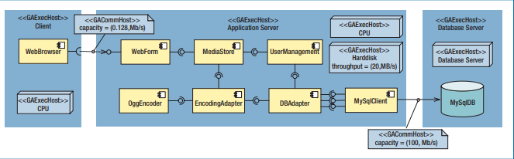
Elements of a Component Model

Slide 76
Component Based Development

Slide 77
Component Based Development
This process basically consists of three main stages namely
qualification,
adaptation and
composition

Slide 78
Component Qualification
Component qualification ensures that a candidate component
will perform the function required,
will properly fit into the architectural style specified for the system, and
will exhibit the quality characteristics (e.g., performance, reliability, usability) required for the application.

Slide 79
Component Adaption
Most of the times even after the component has been qualified for use in the architecture it exhibits some conflicts.
To soothe these conflicts certain techniques such as component wrapping is used.

Slide 80
Wrapping
White-Box wrapping – this wrapping involves code level modifications in the components to avoid conflicts.
This is not widely used because the COTS products are not provided with the source code.

Slide 81
Wrapping
Grey-Box wrapping- applied when the component library provides a component extension language or API that enables conflicts to be removed.
Black-box wrapping - introduction of pre- and post-processing at the component interface to remove or mask conflicts.

Slide 82
Component Composition
Architectural style depends the connection between various components and their relationships.
The design of the software system should be In such a way that most of the components are replaceable or can be reused in other systems.

Slide 83
Benefits
Ideally the components for reuse would be verified and defect-free.
As the component is reused in many software systems any defect if there would be detected and corrected. So after a couple of reuses the component will have no defects.

Slide 84
Benefits
Productivity is increased as every time the code need not be re-written from the scratch.
The time taken to design and write the code also decreases with the use of software components.

Slide 85
Limitations
It can be difficult to find suitable available components to reuse.
Adaptation of components is an issue.

Slide 86
HAVE A GOOD DAY!

